Slide 1
Maslow’s Hierarchy
Sanya Mehra

Slide 2

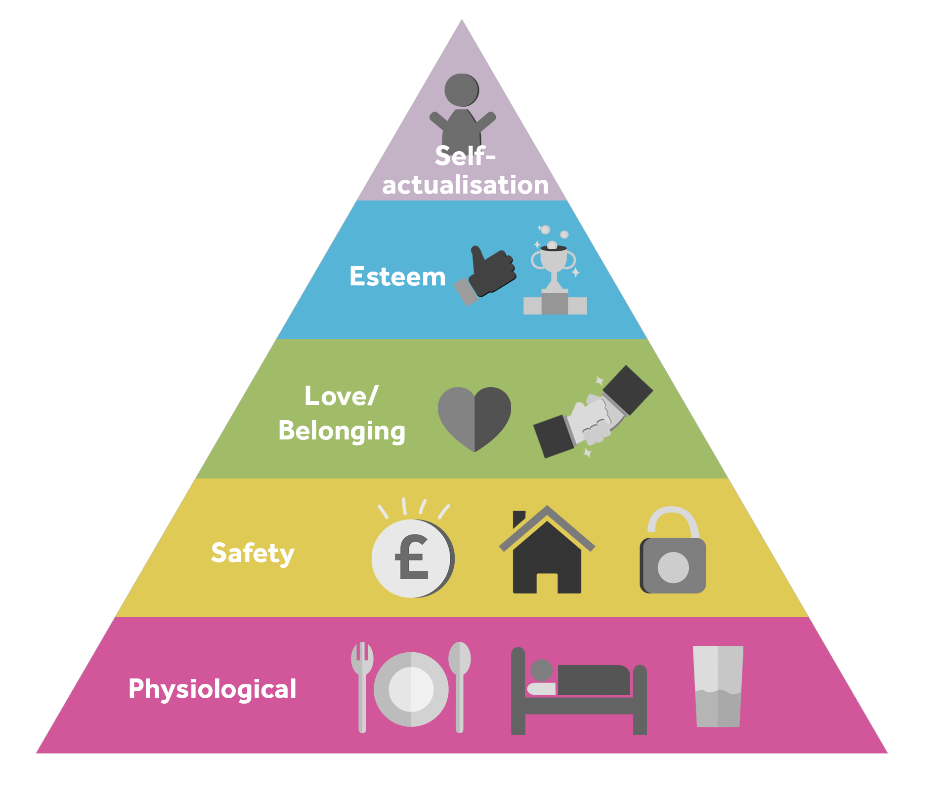



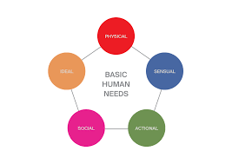
THE FIVE STAGES

Slide 3
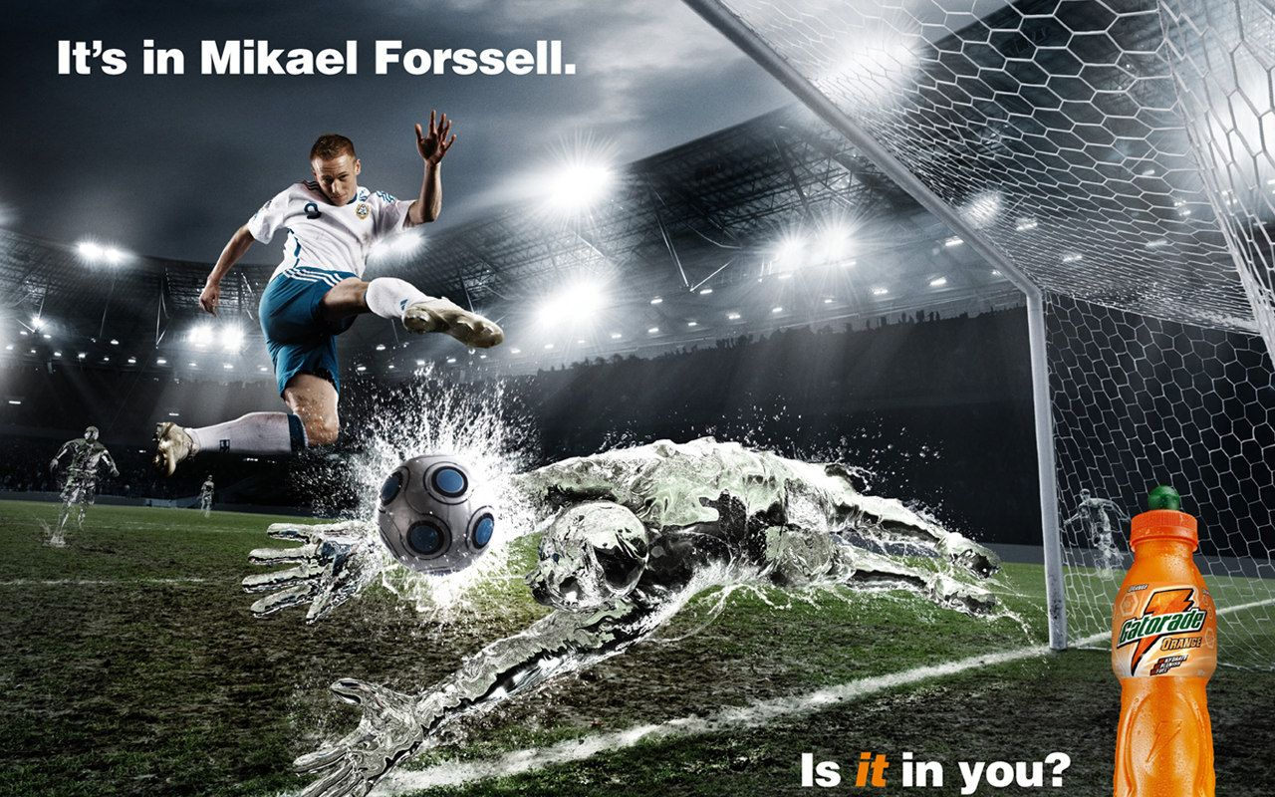
Self-Actualization
Definition: Desire to become the best
The product being served here is Gatorade.
This appeals to Maslow’s Hierarchy of Needs because it’s advertised using a famous football striker, Mikael Forssell.
The advertisement is effective because it attracts the attention of soccer fans. So, majority of the people would want to buy it to become just like Mikael Forssell.

Slide 4
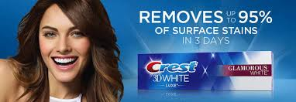
Esteem
It stands for respect, self-esteem, strength, recognition, status and freedom.
The product shown here is Crest 3D White Toothpaste.
This appeals to the Maslow’s Hierarchy of Needs because shows a woman who is recognized for her perfect teeth.
This advertisement is effective because it attracts the attention of people who want to become like the women in the advertisement. They want recognition and status.

Slide 5
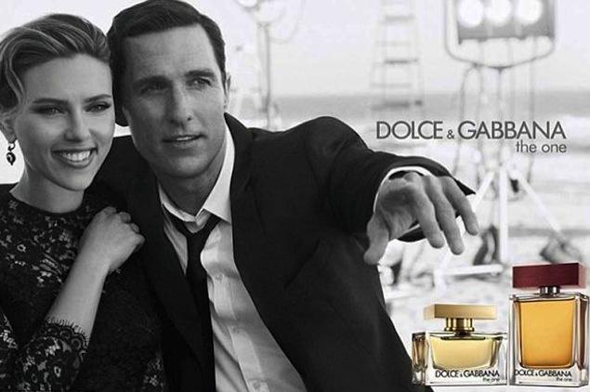
Love and Belonging
It stands for friendship, family, sense of connection and intimacy.
The product being advertised is a brand of perfume called “Dolce and Gabbana”.
This advertisement appeals to Maslow’s Hierarchy of Needs because it shows two people with a connection and intimacy.
This advertisement is effective because it shows being close and having a connection with someone, which everyone desires.

Slide 6

Safety
It stands for personal security, resources, property, health and employment.
The products being advertised are smoke alarms.
This advertisement appeals to Maslow’s Hierarchy of Needs because the product provides personal security and property.
This advertisement is effective because many people would want smoke alarms for their personal security, health and property.

Slide 7

Physiological Needs
It stands for shelter, food, water, reproduction, sleep and air.
The product being advertised is a bottle of “Smartwater”.
This advertisement appeals to Maslow’s Hierarchy of Needs because water is physiological need.
This advertisement is effective because it uses a well known celebrity to promote a physiological need.

Slide 8
Thank you!

